Slide 1
CODALZ
Joshua McDaniel, Xavery Scott, Samantha Jones, Joshua Davis and Matthew dehoFF

Slide 2

What is Codalz?
Codalz is a word game
Each round, a player is given 5 strings of 6 random letters
The player must make as many words as possible from each string
Players can log in, log out, and create a new account
Players can see all previous scores

Slide 3
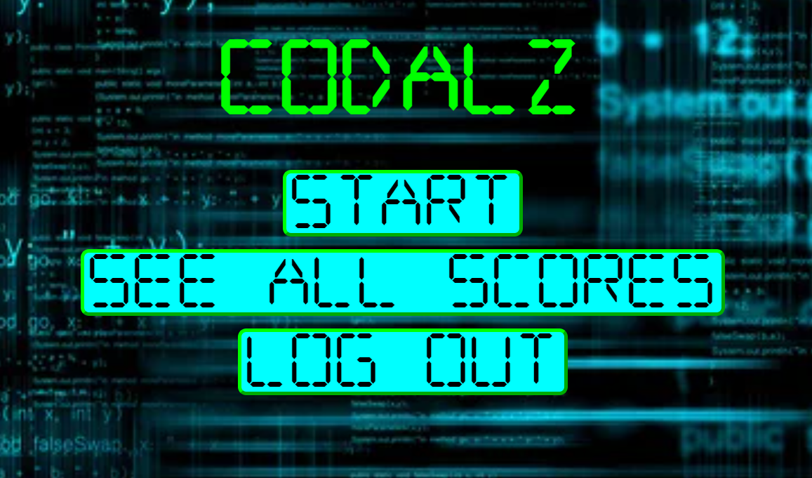

LOGOUT PAGE
HOME PAGE

Slide 4
Technologies
React
Hibernate
JUnit
Dictionary API

Slide 5
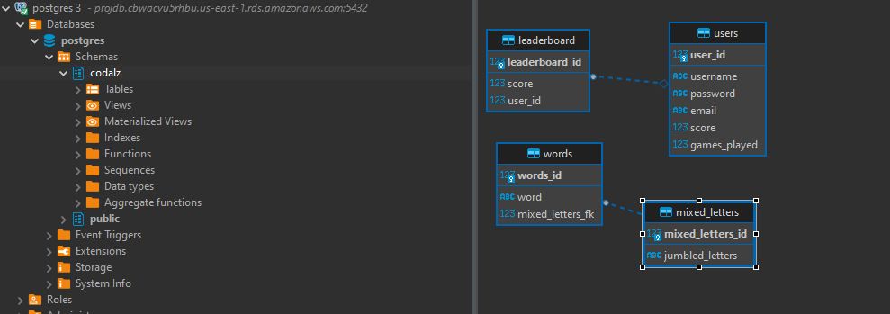
Codalz Database

Slide 6

Possible Improvements
There is a lot of room to add some extra fun details in the future
Adding some more strings to the database so that there is the ability to create more unique words, and to make each round completely different

Slide 7

PROJECT DEMO

Slide 8

Questions?

